Slide 1
Microservices
Architecture
Session 1
Prepared by:
Apurva Sawhney
Preeti Kanyal

Slide 2
Overview
Organizations are becoming more Agile to respond faster to market opportunities, regulatory requirements, and security vulnerabilities
The Agile movement has brought the principles and practices of continuous integration and delivery (CI/CD). Microservices Architecture allows individual services to be built and deployed independently and dynamically; it’s an architecture that embraces DevOps practices
Cloud computing has made tremendous progress in terms of cost and availability in recent years
Microservice Architecture (MSA) is an emergent pattern for building distributed applications that supports agile delivery and scalable deployment, both on-premises (VMs) and to the cloud (PaaS)
Designing good Microservices and implementing them on a large scale is challenging
The good news is that there are many technologies and design patterns that we can use to implement, deploy and monitor Microservices
Notes:
What do you think – what industries or different businesses are demanding these days?
Before going through the concepts of microservices architecture; lets have a quick overview of what the industry is demanding. In today’s extremely competitive business environment, customers are more demanding than ever and will abandon a business that is too slow to respond.
Microservice architecture has the potential to address this business challenge; it is all about achieving speed, scalability and flexibility to pick and choose technology for implementing a solution.

Slide 3
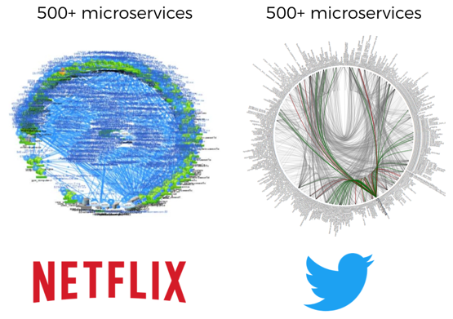
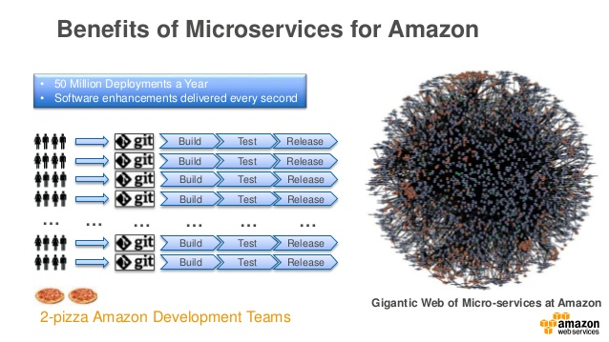
Who is embracing microservices?
https://www.slideshare.net/AmazonWebServices/introduction-to-microservices-74259780
Notes:
There are some big names – Netflix, Twitter, Amazon, eBay, Uber and many more.
Netflix is the king of microservices. Netflix began to move their monolithic architecture to a cloud-based microservices architecture in 2009. At that time, the term microservices didn’t even exist. Today, Netflix engineers deploy code thousand times a day. Netflix's deployment frequency is 16 minutes.
Another big name is Amazon – Amazon has hundreds of microservices. Microservice architecture allowed Amazon’s transition to continuous deployment, and now Amazon engineers deploy code every 11.7 seconds.
Imagine how many releases amazon have been deployed while we were just discussing this slide. Quite exciting… right?
The big advantage of microservices are millions of deployments in a year and software enhancements delivered every second.

Slide 4
Agenda
Traditional applicational architecture and its problems
Introduction to microservices architecture(MSA)
Monolithic vs SOA vs Microservices
When to use microservices?
When not to use microservices?
Challenges with MSA
Designing a microservice
Fundamentals of microservices communication
Service Registry and Discovery
Orchestration
Choreography
API Gateway
Microservices data management

Slide 5
How applications were designed traditionally?
Notes:
So before moving straight away to microservices architecture lets talk about some old architecture styles and discuss how that old styles evolved into microservices architecture.
Do you know layered and tiered architecture? Layers are logically separated; Tiers are physically separated.
The first one to discuss is monolithic architecture.

Slide 6
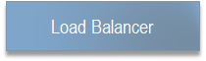
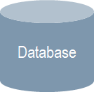
Monolithic architecture
Single and large codebase
Most often every layer is in a separate package
Many components, no clear ownership
Single RDBMS serves as a data store for entire application. Hence, strongly consistent transactions are more popular.
Long deployment cycles
Monolithic App
Account
Component
Product
Component
Customer
Component
Notes:
When developing an application we can start it with a modular hexagonal or layered architecture which consists of different types of components like presentation layer, business logic, database access and integration layer. Despite having a logically modular architecture, the application is packaged and deployed as a monolithic.
A monolithic application has single and large code base with multiple modules.

Slide 7
Monolithic architecture- How it scales?
Puts all functionality in a single process
Scaling takes place by replicating the monolith on separate servers
Monolithic App
Account
Component
Product
Component
Customer
Component
Notes:
Next is how scaling happens in a monolithic architecture?
Till now we know that monolithic architecture puts all functionality in a single process. So whenever there is a need to scale it, the scaling takes place by replicating complete monolithic app on separate servers.
Do you see any concern here?
Even though we want to scale only a single module, we are forced to replicate everything which is not even required.

Slide 8
Problems | Monolithic architecture
“Spaghetti”, “big ball of mud” code
Tightly coupled
Code changes triggers full redeploy
Scaling issues
Rapid application development
Technology evolution
Continuous delivery
Change management
Overloads your IDE
Scaling issues
Change management
Technology evolution
Rapid application development
Continuous delivery
Overloads your IDE
Spaghetti Code
Code changes trigger full redeploy
Notes:
In a monolithic architecture, application is too large and complex to fully understand and made changes fast and correctly. Things are tightly coupled.
You must redeploy the entire application on each update.
Scaling issues : Difficult to scale the application as it has to run multiple instances behind a load balancer. As we have discussed in previous slide individual component scaling is not possible.
Technology evolution: Monolithic architectures are not able to support fast technological changes and the lesser time to market. Monolithic applications has a barrier to adopting new technologies. Since changes in frameworks or languages will affect an entire application and it is extremely expensive in both time and cost.
Continuous delivery: It’s quite challenging to follow a continuous delivery practice when there is a single large code base as each component/module needs to be built, tested, and deployed for change.

Slide 9
SOA in brief
Service Oriented Architecture tries to address the above challenges by segregating the business functionalities of monolithic applications into services which are:
reusable,
loosely coupled
Coarse grained
Service – Self-contained implementation of business functionality
Enterprise Service Bus (ESB) is used to integrate those services, data, and systems
Notes:
SOA.. Another architectural style is SOA i.e. Service Oriented Architecture.
SOA tries to address the challenges of monolithic architecture by segregating the business functionalities of monolithic applications into services. These services are reusable, loosely coupled and coarse grained.
A service is a self-contained implementation of a well-defined business functionality that is accessible over the network (SOAP/REST)
The consumers are only concerned about the service interface and do not care about its implementation
Composite services can be built from aggregates of other services
Enterprise Service Bus (ESB) is used to integrate those services, data, and systems
To sum up, Service oriented architecture is a design approach where multiple services collaborate to provide some end set of capabilities. It is an approach that aims to promote the reusability of software; for example two or more end-user applications could both use same services.

Slide 10
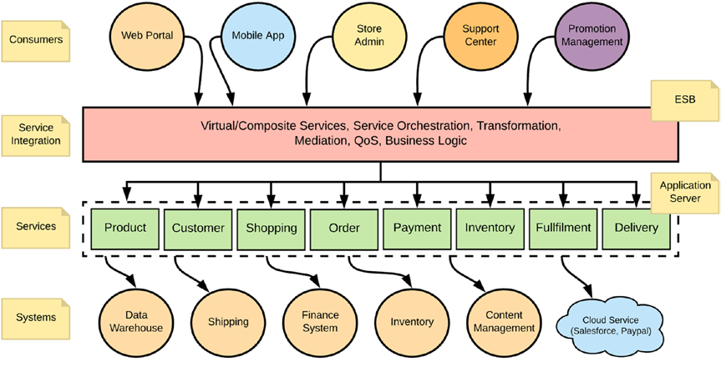
SOA in brief cont.
Notes:
Here we have consumers, a service integration layer could be an ESB, multiple coarse grained services based on business functionalities and some other systems with whom the services are interacting.

Slide 11
Microservices architecture
Notes:
So, we have discussed monolithic and SOA architectures and Now comes the microservices architecture…
Microservices architecture is one in which an application is developed into loosely coupled small separate services that speak to one another through APIs. Each Microservice is self-contained, maintains its own data store and can be updated independently of others.
It is actually an evolution of SOA (Service-oriented architecture) which was quite popular some years back.

Slide 12
Microservices – A “style” of software architecture
Many smaller, clearly scoped services
Single Responsibility Principle
Domain Driven Development
Bounded Context
Independently managed(versioned, deployed or scaled)
Language and framework agnostic
Are developed by a small development team
Example: e-commerce
Inventory management
Order management
Web store front-end
Product Management (catalog of products)
Customer Management
Notes:
Microservices are small, autonomous services. They are loosely coupled and are organized around business capabilities.
Business capability is something a business does to deliver value. Each business capability is equivalent to one service. The bounded context is the logical boundary. Microservices should cleanly align to bounded contexts. This ensures that microservices are loosely coupled and highly cohesive.
Each service runs a unique process and communicates through a well-defined, lightweight mechanism to serve a business goal. With microservices architecture, one delivers software rapidly, frequently and reliably.
With microservices, we can make a change to a single service and deploy it independently of the rest of the system. With this we have faster code deployment and in case of any issues faster rollbacks. It also means, we can get our new functionality out to the customers faster.
Microservices are technology agnostic APIs. With a system composed of multiple, collaborating services, we can decide to use different technologies inside each one. This allows us to pick the right tool for each job rather than having to select a more standardized, one size fits all approach. If one part of our system needs to improve performance, we might decide to use a different technology stack that is better able to achieve the performance levels required. For example, for a social network, we might store our users interactions in a graph-oriented database to reflect the highly interconnected nature of a social graph. But for posts a better option could be document-oriented data store. This give microservices a heterogeneous architecture.
Microservices are developed by a small development team. People at Amazon says – the size of team should be small enough so that two-pizzas can feed them.
Lets consider an example of an e-commerce application -

Slide 13
Defining microservice architecture
“…the microservice architectural style.. ..is an approach to developing a single application as a suite of small services, each running in its own process and communicating with lightweight mechanisms, often an HTTP resource API. …”
Martin Fowler
http://martinfowler.com/articles/microservices.html
Notes:
As per Martin Fowler, the definition of microservice architectural style is -----

Slide 14
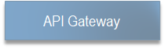
Microservice architecture
Order API
Product API
Recommendation API
Order DB
Product DB
Recommendation DB
Notes:
This is a very high level diagram of microservices architecture…

Slide 15
Microservice architecture- How scaling occurs?
Review
Product
Recommendation
Review
Product
API
Order
API
API
API
API
API
Review
Product
Recommendation
Service
Service
Product
Service
Review
Product
Recommendation
Order
Service
Product
Service
Service
Service
Service
Service
Notes:
With a large monolithic service, we have to scale everything together.
With smaller services, we can just scale those services that need scaling, allowing us to run other parts of the system on smaller and less powerful hardware.

Slide 16
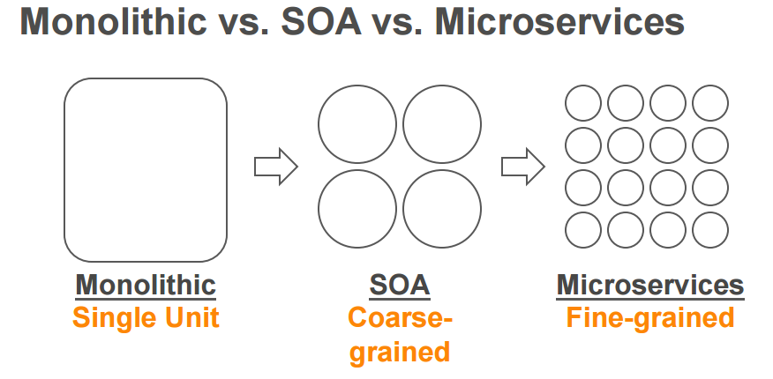
At high level – Monolithic, SOA, MSA
Notes:
Monolithic Architecture is similar to a big container wherein all the software components of an application are assembled together and tightly packaged.
A Service-Oriented Architecture is a collection of services which communicate with each other. The communication can involve either simple data passing or it could involve two or more services coordinating some activity.
Microservice Architecture is an architectural style that structures an application as a collection of small autonomous services, modeled around a business domain.

Slide 17
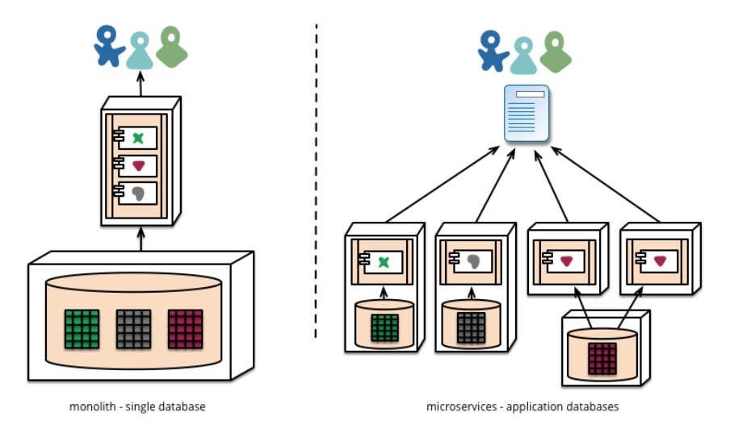
Monolithic vs Microservices
Modules running in different processes
Decentralized data management
Notes:
A monolithic application puts all its functionality into a single process where as a microservice architecture puts each element of functionality into a separate service
Microservices are language-agnostic APIs
Monolithic application scales by replicating the monolithic on multiple servers.
Microservices scale by distributing these services across servers, replicating as needed.

Slide 18
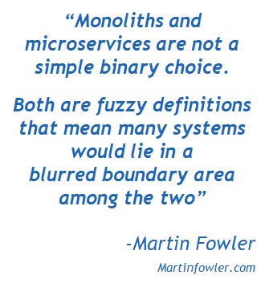
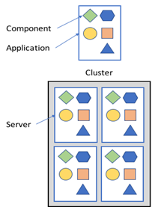
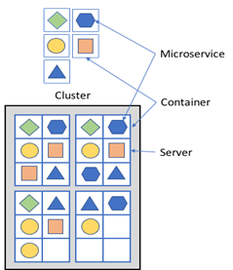
Monolithic vs Microservices
Traditional Monolithic Architecture Pattern
Microservice Architecture Pattern

Slide 19
Comparing SOA and MSA

Slide 20
How's?? When using microservices:
Deployment of application services
Decomposition of application to services
Prevent cascading of service failure
Service instance discovery by client
Communication of external clients with service
Handling of cross cutting concerns
Communication mechanism to use
Maintain data consistency and implement queries
Notes:
How to decompose application to services?
How to deploy an application’s services?
How to handle cross cutting concerns?
Which communication mechanism to use?
How do external clients communicate with the service?
How does a client discover network location of a service instance?
How to prevent a network or service failure from cascading to other services?
How to maintain data consistency and implement queries?
How to understand the behavior of an application and troubleshoot problems?
How to make testing easier?
How to implement a UI screen or page that displays data from multiple services?

Slide 21
When & When NOT to use microservices?
Difficult to scale
Faster and simpler deployments and rollbacks
Complexities of growing applications
Failure Cascade
Right framework/tool/language for each domain
Greater resiliency

Slide 22
Challenges with Microservices
Finding seams
Refactoring databases
More Integrations
Monitoring and Testing
Duplicated code
More configuration management
Overall complexity
Notes:
Identification of seams that can become service boundaries. To start – one should identify the high level bounded contexts that exists in the organization. We need to find seams in the databases as well, so that we can split the databases cleanly.

Slide 23
Designing microservices

Slide 24
Microservices Design Principles
Design principles for microservices design:
High Cohesion
Measure of the contextual relationship between variables in a method, methods in a class, classes in a module, modules in a solution, solutions in a subsystem, and subsystems in a system
Weak contextual relationships == low cohesion == brittle in nature == more prone to error & change
Bounded context helps us to achieve strong contextual relationship
Loose Coupling
Coupling is a measure of the interdependence between different systems (microservices)
Single responsibility (SRP)
The single responsibility principle states that a component or a system that adheres to it should only have one reason to change. A highly cohesive and loosely coupled system will naturally follow the single responsibility principle
Resilience
Capability to recover quickly from a failure
Redundancy is the key
Developer mindset focusing on recovery-oriented development helps in building more resilient software
Notes:
Related behavior should sit together and unrelated behavior should sit elsewhere. This is because if we want to change behavior we want to be able to change it in one place and release that change asap. We want to make and deploy change easily. so high cohesion is important.
When services are loosely coupled , a change to one service should not require change to other services. One important point is choice of integration style, which should be chosen keeping in mind low coupling.
A loosely coupled service should know minimal about the service it collaborates with. Means we should also avoid number of calls between services.
SRP says: Gather together those things that change for the same reason and separate those things that change for different reason.
One of the advantages of building distributed systems as microservices is the ability of the system as a whole to withstand faults and unexpected failures of components, networks, compute resources, etc.
Idea behind resiliency is that: if our monolith fails, everything for which it’s responsible fails along with it; so let’s break things into smaller chunks so we can withstand individual pieces of our app failing without affecting the entire system. It’s important to think this way when providing a service in a microservice architecture. What happens when collaborator services are unavailable? What happens when things go wrong? Or when services fail? A service may go down in the middle of a transaction. A mis-behaving service may be inadvertently pounding our service with requests. A consuming service may experience latency in the network (expect this in cloud deployments!) and may have timed-out and retried. What fallback procedures are available ? A lot of times this fallback may be dictated by the business. Maybe you returned a canned response. Maybe you call a different service as a back up. Maybe you do a simplified calculation yourself. Either way, in the face of some unexpected fault, you should think through what alternatives there are to help fulfill (or partially fulfill) the service promise.

Slide 25
Microservices Design Principles cont.
Timeouts
Circuit Breaker
In our home circuit breakers exist to protect electrical devices from spikes in power. If a spike occurs, circuit breaker gets blows , protecting the home appliances.
Component that can circumvent calls when the system is not healthy
Maintains some threshold value for failures and if it is met, then will break the circuit
Bulkheads
In shipping , a bulkhead is a part of the ship that can be sealed off to protect the rest of the ship. So if ship springs a leak , bulkhead doors could be closed.
Bulkheads pattern partitions capacity to preserve partial functionality when bad things happen
Example – redundancy in deployment, ach instance works as a bulkhead.
Let It Crash
Suggests getting back to a clean start-up as rapidly as possible, in case the recovery is difficult and unreliable due to a failure
Very common strategy in microservice deployments (one microservice per host strategy with containers)
Rapid server start-up time is also a key aspect
Notes:
Tmeouts prevent service calls from waiting indefinitely for a response.If there is no response by the timeout, the service invokes a fallback mechanism, whether it’s retrying the request, throwing an exception, or something else. Choosing the correct timeout is important. Waiting too long to decide if the call failed will slow down the system and timing out too quickly can consider a successful call as failed. It is important to put timeouts for all the calls, log when timeout occurs look at what happens and change it accordingly.
With a circuit breaker , after a certain number of requests have failed , the circuit breaker is blown. All further requests will fail fast whle the circuit breaker is in blown state. After a certain period of time the client sends a few requests to see if the service has recovered and if it gets enough healthy responses , it resets the circuit breaker.
A key concept in resilience engineering is Bulkhead. If one component of a system fails but the failure doesn't cascade, you can isolate the problem and rest of the system can keep working. Service boundaries become obvious bulkheads. With microservices we can build systems that handle the total failure of services and degrade functionalities accordingly.
According to Let it Crash: rather than trying to handle and recover from all possible failures, you should instead simply fail early and let your processes crash, but then recycle them back into the pool to serve the next request. Plan the system such that , if the components or services in the application did crash, the system could recover with or without human intervention. So how to implement it in practice:
Hardware failures can be handled in cloud without affecting the entire service. At service level , if 1 service fails , application can degrade carefully while service is unavailable or fallback to another instance while the first one is recycling. Nothing should be in critical code path because it might crash. At the network level, we can design topologies such that we do not care if routers or network links crash because there’s always some alternate route through the network. Let them crash and when they come back the optimal routes will be there ready for our application to make use of again in future .Let it crash is more than simple redundancy. It’s about implementing self recoverability of the application. It’s about putting the site reliability efforts into your architecture rather than low level defensive coding.

Slide 26
Designing Microservices architecture
What all microservices we need to develop in the application?
What would be the scope of a microservice?
How the microservices are going to interact?
What to manage the data?
How to handle cross cutting concerns?
What should be the deployment. Strategy?
Notes:
the system needs to be decomposed into multiple components where each component becomes a microservice. Microservices have to be lightweight, in order to facilitate smaller

Slide 27
Designing microservices
Three key tasks in designing the microservices :
Decomposing the business problem
Establishing service granularity
Defining the service interfaces
We would follow one of the most popular software design approach, Domain Driven Design (DDD) to achieve above tasks.
Notes:
One of the well known design pattern to deal with complex problems is Domain driven design. DDD approaches is applicable only for complex problem with significant business rules.
DDD patterns help you understand the complexity in the domain and connects the implementation to the core business concepts.

Slide 28


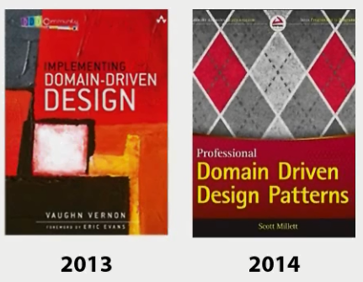
Domain driven design
Not a new concept introduced with microservices and has been around for quite some time
Plays a key role in scoping out microservices (right level of granularity for each service)
Principles & Patterns to solve difficult problems
History of success with complex projects
Clear, testable code that represents the domain

Slide 29
Domain driven design cont.
Domain
Domain is the business area that project covers.
Example domains could be automobile, banking, manufacturing, airline, content management, e-commerce etc.
Subdomain
A domain can be decomposed into subdomains, which is one part of the domain
Bounded Context
Explicit boundary within which a domain model exists; is at the heart of a microservices design,
Any given domain consists of multiple bounded contexts, each encapsulates related functionalities into domain models
Defines integration points to other bounded contexts via explicit interface, where it defines what models to share with other servies.
Notes:
the context of building applications, DDD talks about problems as domains.
A domain can be decomposed into subdomains, which is one particular part of the domain. Each subdomain can contain further subdomains. There can be communication between various subdomains
A bounded context is a conceptual boundary where a domain model is applicable. The entire business model is too large and complex to understand as a unit and not feasible to maintain a unified model for an entire enterprise. We need to mark boundaries and relationships between different models. Having bounded contexts also helps to formalize the interactions between different services and build the interfaces between them effectively and efficiently. Bounded Context is the basic needs, when you are trying to break a large business logic it helps you to understand how different part of the system use domain objects in a different manner with different terminology. Bounded Context is just a view to properly organize the business logic based on functionality but to make the business logic works -- communication between Bounded context needed, and it uses Context Map for the same. each business entity/value object has a certain meaning in that context, so every stakeholder of the business (product owners, developers, architects, and sponsors) understand the context and refer to entities with the proper taxonomy.
With bounded context, we properly define a business model, create a different context based on the business domains, but always a functionality spans over multiple business entities , and those entities lie in the different Bounded contexts/domains, so it is utmost important to understand the relationship between the Bounded contexts, to architecting the business solution Context Map is a technique by which we can visualize the relationship between different contexts and Integration architect choose the best integration patterns to communicate to other contexts.
.

Slide 30
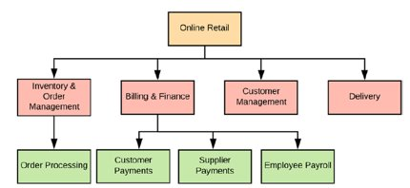
Domain driven design cont.
Notes:
Inventory and order management domain (customer - > order history, open orders, and scheduled orders)
Customer management domain (customer -> properties such as first name, last name, home address, email address, mobile etc)
Billing & finance domain (customer -> credit card number, billing address, billing history, and scheduled payments)
===============================
SOA - will not worry about inventory and order management, billing and finance, delivery and customer management as separate independent domains—but rather will treat the complete system as an enterprise e-commerce application.

Slide 31
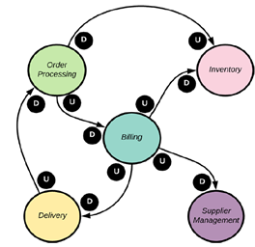
Ubiquitous language
Same language must be used everywhere within a given context, from conversations to code
Shared team language, bridges the gap in communication between domain experts and developers
Example list of terms that could be included could be: Discount, Item,Order, provider, purchase Agreement, Tax, Unit Price, Unit Gross Margin etc.
Context Map
When the number of bounded contexts in an enterprise grows, it could easily become a nightmare to figure out how they are connected
Helps in visualising the relationships between bounded contexts
Notes:
Ubiquitous Language is the term uses in Domain-Driven Design for the practice of building up a common, rigorous language between developers and users. This language should be based on the Domain Model used in the software
Context map helps to visualize relationship between bounded contexts so that architect can decide which technical solution can be adapted. In microservice architecture where microservices are owned by different teams , it is very important to understand how one team is dependen on another. E.g. when developing a functionality, e.g. ordering a product, its mendatory to visualize whcih context would be affected? Which all teams or microservices would need to be involved? Whta would be their relationship ? Context map would help to model all these questions.
Context map talks about the nature of the relationship. It not only tells us whether a relationship is upstream or downstream, publisher or subscriber, it also tells how different teams are dependent on other teams, their motifs, their politics...everything. Counting all of that, now the architect in a position to decide the optimal solution to minimize risk while integrating with another context.
Customer/Supplier
Generally, this is the common relationship between two contexts, where a context consumes or depends on data from another context. The context which produces data is marked as upstream and the context which consumes data is called downstream.
The domain model is a representation of meaningful real-world concepts pertinent to the domain that need to be modeled in software. The concepts include the data involved in the business and rules the business uses in relation to that data. A domain model generally uses the vocabulary of the domain, thus allowing a representation of the model to be communicated to non-technical stakeholders.

Slide 32
Decomposing the business problem
Interview the business stakeholders to understand the problem in hand.
Using the DDD approach to define domain, subdomain and bounded context for the problem.
Each Bounded Context could map to a microservice.

Slide 33
Establishing the service granularity
It’s better to start broad with microservice and refactor to smaller services.
Focus first on how services will interact with one another.
Service responsibilities will change over time as understanding of the problem domain grows.
Smells of a too coarse grained microservices:
Too coarsely grained service will have too many responsibilities.
The service is managing data across a large number of tables
Too many test cases
Smells of a too fine grained microservices:
Each service interacts with only a single database table.
Microservices are heavily interdependent on one anotherToo many test cases
Microservices become a collection of simple CRUD (Create, Replace, Update, Delete) services
Notes:
Based on the data model you can see the potential for multiple microservices . The goal is to take these major pieces of functionality and extract them into completely self-contained units that can be built and deployed independently of each other. But extracting services from the data model involves more than repackaging code into separate projects. It’s also about teasing out the actual database tables the services are accessing and only allowing each individual service to access the tables in its specific domain.
It’s better to start broad with your microservice and refactor to smaller services—It’s easy to go overboard when you begin your microservice journey and make everything a microservice. But decomposing the problem domain into small services often leads to premature complexity because microservices devolve into nothing more than fine-grained data services.
2 Focus first on how your services will interact with one another—This will help establish the coarse-grained interfaces of your problem domain. It’s easier to refactor from being too coarse-grained to being too fine-grained.
3 Service responsibilities will change over time as your understanding of the problem domain grows—Often, a microservice gains responsibilities as new application functionality is requested. What starts as a single microservice might grow into multiple services, with the original microservice acting as an orchestration layer for these new services and encapsulating their functionality from other parts of the application.

Slide 34
Defining the service interfaces
Service interfaces would be used by clients to talk with microservices.
Clients of a microservice could be application front-end, other microservices in the application or any third-party applications.
Design Guidelines:
Embrace the REST philosophy
Use URI’s to communicate intent
Use HTTP status codes to communicate results.
Use JSON for your requests and response.
Notes:
The last part of the of the is about defining how the microservices in your application are going to talk with one another. When building business logic with microservices, the interfaces for the services should be intuitive and developers should get a rhythm of how all the services work in the application by learning one or two of the services in the application. In general, the following guidelines can be used for thinking about service interface design:
1 Embrace the REST philosophy—The REST approach to services is at heart the embracing of HTTP as the invocation protocol for the services and the use of standard HTTP verbs (GET, PUT, POST, and DELETE). Model your basic behaviors around these HTTP verbs.
2 Use URI’s to communicate intent—The URI you use as endpoints for the service should describe the different resources in your problem domain and provide a basic mechanism for relationships of resources within your problem domain.
3 Use JSON for your requests and responses—JavaScript Object Notation (in other words, JSON) is an extremely lightweight data-serialization protocol and is much easier to consume then XML.
4 Use HTTP status codes to communicate results—The HTTP protocol has a rich body of standard response codes to indicate the success or failure of a service. Learn these status codes and most importantly use them consistently across all your services.
Your microservices are heavily interdependent on one another—You find that the microservices in one part of the problem domain keep calling back and forth between each other to complete a single user request. Your microservices become a collection of simple CRUD (Create, Replace, Update, Delete) services—Microservices are an expression of business logic and not an abstraction layer over your data sources. If your microservices do nothing but CRUDrelated logic, they’re probably too fine-grained.
All the basic guidelines drive to one thing, making your service interfaces easy to understand and consumable. You want a developer to sit down and look at the service interfaces and start using them. If a microservice isn’t easy to consume, developers will go out of their way to work around and subvert the intention of the architecture.

Slide 35
Fundamentals of microservices communication
Notes:
How the services collaborate?

Slide 36
Concept
Service A
Service D
Web Application
Service B
Service E
Service C
Notes:
Inter-service communication is essential to consider when building microservices.
The biggest challenge when changing from a monolithic application to a microservices-based application lies in changing the communication mechanism. A direct conversion from in-process method calls into RPC calls to services will cause a chatty and not efficient communication that won't perform well in distributed environments.
One solution involves isolating the business microservices as much as possible. You then use asynchronous communication between the internal microservices and replace fine-grained communication that's typical in intra-process communication between objects with coarser-grained communication. You can do this by grouping calls, and by returning data that aggregates the results of multiple internal calls, to the client.

Slide 37
Inter service communication
Microservices are autonomous and communicate over the network (may be at different locations) as part of distributed system to fulfill a business use case
Microservices communicate with each other through messaging
Synchronous messaging:
In synchronous communication style, the client sends a request and waits for a response from the service
Most common communication protocols used for synchronous messaging are:
REST
Richardson Maturity Model
gRPC
focused on high performance inter-service communication developed by Google as part of project Stubby
Websockets
uses a single TCP connection for bidirectional traffic and uses HTTP as the initial handshaking
GraphQL
provides a query language for APIs and a runtime for fulfilling those queries with existing data
Notes:
The first step is to define whether a protocol is synchronous or asynchronous.
In synchronous communication, the client sends a request and waits for a response from the service. The thread will be blocked until it receives communication back. Interestingly, using that protocol, the client can communicate asynchronously with a server, which means that a thread is not blocked, and the response will reach a callback eventually. The most relevant protocol to implement synchronous communication is HTTP. HTTP can be implemented by REST or SOAP.

Slide 38
Inter service communication cont.
Asynchronous messaging:
In the asynchronous communication, client doesn’t wait for a response in a timely manner.
The asynchronous messaging uses a lightweight and dumb message broker having no business logic. Broker is a centralized entity with high-availability
There are two main types of asynchronous messaging styles
single receiver
Advanced Message Queuing Protocol (AMQP) protocol is the most commonly used standard
The publishers produce the messages and the consumers pick them up and process them
AMQP ensures reliability of message delivery and message acknowledgements
and multiple receivers
Apache Kafka (which has its own messaging protocol) is the most widely used message broker
Producer publish an event on event bus on a topic and consumers subscribe to the topic
Kafka message durability, in order access, data is distributed within the Kafka system for failover and scalability
Notes:
When we talk about asynchronous communication, it means the client makes a call to the server, receives acknowledgment of the request, and forgets about it. The server will process the request and complete it. Asynchronous style can be implemented either via messaging or can be event-driven.
The key point here is that the client should not have blocked a thread while waiting for a response. The message producer usually does not wait for a response. It just waits for acknowledgment that the message has been received by the broker. The most popular protocol for this type of communication is AMQP (Advanced Message QueuingProtocol), which is supported by many operating systems and cloud providers. The most popular message brokers are RabbitMQ and Apache Kafka.
Asynchronous style defines whether the communication has a single receiver or multiple receivers. In one-to-one communication, each client request is processed by exactly one service instance, while in multiple-receivers each request can be processed by many different services.
It is worth it to point out here that one message is received by different services, but usually it should not be received by different instances of a single service.
A microservice-based application will often use a combination of these communication styles.

Slide 39
Microservices Communication Patterns

Slide 40
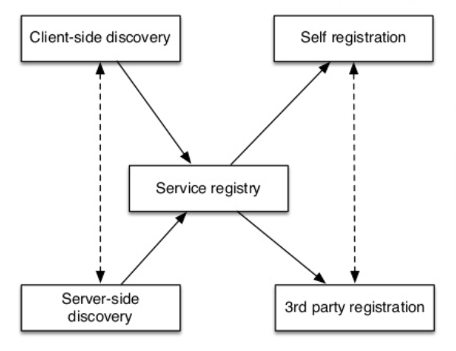
Service Registry and Discovery
Client needs IP address of service instance
Dynamic IP addresses
Dynamically provisioned instances
Service Registry:
Self-registration
Third party registration
Discovery:
Client-side service discovery
Server-side service discovery
Notes:
Microservices give us a very important key advantage which is ease of scaling.. You will keep adding or removing microservice instances to adapt to incoming traffic. All these instances are dynamic in nature. Service instances have dynamically assigned network locations. Moreover, the set of service instances changes dynamically because of autoscaling, failures, and upgrades. We know that clients need the IP address of the service instances for communication. So now, since the IPs are dynamic, how do you think the clients will get to know with which service they should communicate? The answer to this question is service registry and service discovery.
Service registry helps to keep track of these instances. It is a database containing the network locations of the service instances. Every service instance registers itself on start-up and de-registers on shutdown.
Service registration could be self-registration where the service instances register themselves or third party registration where some other system component manages the registration of service instances.
As a critical component, the service registry needs to be highly available. You should plan for a cluster of registries that uses replication to maintain consistency.
Clients need some service discovery mechanism for discovering which service instance to call.
Client-side Service Discovery - When using client-side service discovery, the client is responsible for determining the network locations of available service instances and load balancing requests across them. The client queries a service registry, which is a database of available service instances. The client then uses a load‑balancing algorithm to select one of the available service instances and makes a request. One significant drawback of this pattern is that it couples the client with the service registry. You must implement client‑side service discovery logic for each programming language and framework used by your service clients.
Server-side Service Discovery - The client makes a request to a service via a load balancer. The load balancer queries the service registry and routes each request to an available service instance. One great benefit of this pattern is that details of discovery are abstracted away from the client. Clients simply make requests to the load balancer.

Slide 41
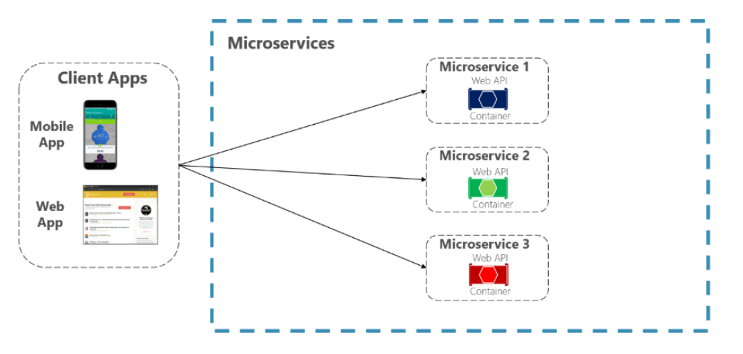
Direct Client-To-Microservice communication
Notes:
In this approach, a client app can make requests directly to some of the microservices
How can client apps minimize the number of requests to the backend and reduce chatty communication to multiple microservices?
Interacting with multiple microservices to build a single UI screen increases the number of round trips across the Internet. This increases latency and complexity on the UI side. Ideally, responses should be efficiently aggregated in the server side. This reduces latency, since multiple pieces of data come back in parallel and some UI can show data as soon as it's ready.
How can you handle cross-cutting concerns such as authorization, data transformations, and dynamic request dispatching?
Implementing security and cross-cutting concerns like security and authorization on every microservice can require significant development effort.

Slide 42
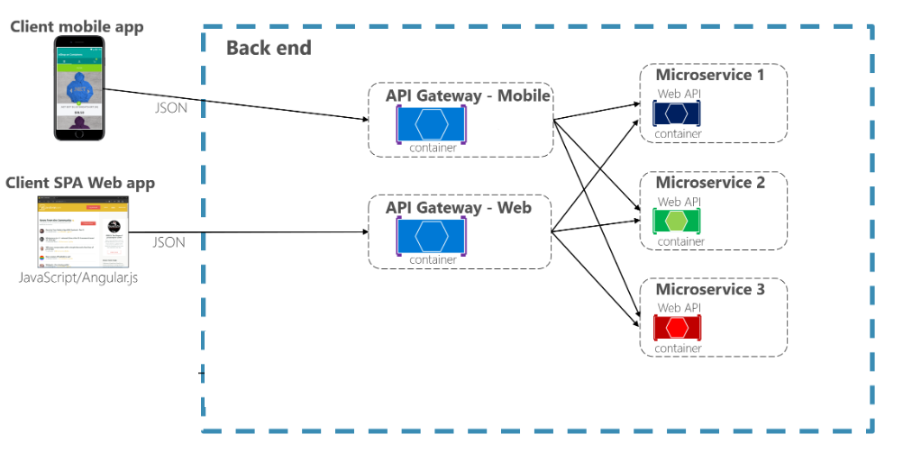
API Gateway
API Gateway is a reverse proxy to microservices and acts as a single-entry point into the system.
It is like a Facade pattern from object-oriented design.
Encapsulates the internal structure of the application.
Responsible for request routing, composition and protocol translation.
Notes:
The gateway abstracts microservices from their consumers, which provides flexibility to freely add or remove microservice instances to adapt to the load/demand of microservices.
With a single-entry point into the system, it becomes easy to enforce runtime governance such as common security requirements, common design decisions and real-time policies such as monitoring, auditing and measuring API usage, and throttling.
The API Gateway encapsulates the internal system architecture and provides an API that is tailored to each client. It might have other responsibilities such as authentication, monitoring, load balancing, caching, request shaping and management, and static response handling.
The API Gateway is responsible for request routing, composition, and protocol translation. All requests from clients first go through the API Gateway. It then routes requests to the appropriate microservice. The API Gateway will often handle a request by invoking multiple microservices and aggregating the results. It can translate between web protocols such as HTTP and WebSocket and web‑unfriendly protocols that are used internally.

Slide 43
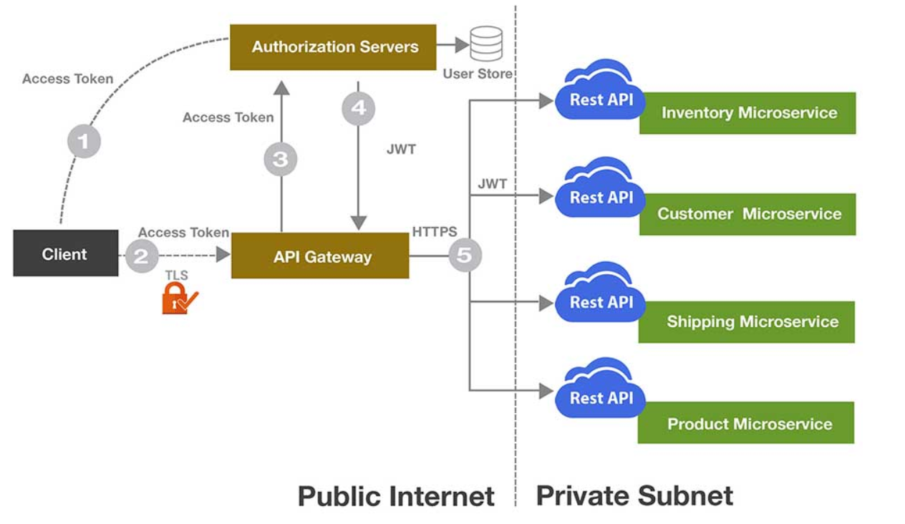
API Gateway and Security
Notes:
Every API request is authenticated at the gateway layer.
On behalf of the end user, the application client first grabs an access token from the authentication server by presenting credentials. This access token is then passed along with the API request in Authorization HTTP header. The API Gateway then validates the access token with the authorization server. The JWT token, which contains the claims for the user, is then passed to backend microservices. Backend microservices then use the information inside the JWT token for authorization purpose. The same JWT token is passed along when one microservice communicates with another microservice.

Slide 44
Circuit Breaker
Microservices need to be extremely reliable.
Microservices does not automatically mean better availability – unless you have fault tolerant architecture
Have fallbacks in case of microservice failure.
Design critical services in fail-safe manner.
Different States of Circuit Breaker:
Closed – everything is normal
Open – circuit breaker returns an error for calls without executing the function
Half Open – after a timeout period, the circuit switches to a half-open state to test if the underlying problem still exists.
Notes:
It's common for software systems to make remote calls to software running in different processes, probably on different machines across a network. These remote calls can fail or hang without a response until some timeout limit is reached. And the worst part is – if you have multiple callers on a unresponsive supplier, then you can run out of critical resources leading to cascading failures across multiple systems.
With circuit breaker, we wrap a protected function call in a circuit breaker object, which monitors for failures. Once the failures reach a certain threshold, the circuit breaker trips, and all further calls to the circuit breaker return with an error, without the protected call being made at all. Further we can have some kind of monitor alert if the circuit breaker trips.
The circuit breaker has three distinct states: Closed, Open, and Half-Open:
Closed – When everything is normal, the circuit breaker remains in the closed state and all calls pass through to the services. When the number of failures exceeds a predetermined threshold the breaker trips, and it goes into the Open state.
Open – The circuit breaker returns an error for calls without executing the function.
Half-Open – After a timeout period, the circuit switches to a half-open state to test if the underlying problem still exists. If a single call fails in this half-open state, the breaker is once again tripped. If it succeeds, the circuit breaker resets back to the normal, closed state.

Slide 45
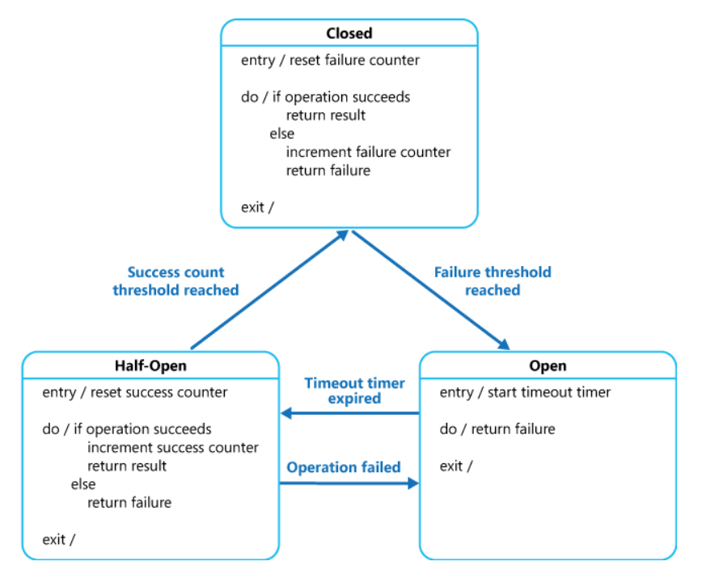
Circuit Breaker
Notes:
The purpose of the Circuit Breaker pattern is different than the Retry pattern. The Retry pattern enables an application to retry an operation in the expectation that it'll succeed. The Circuit Breaker pattern prevents an application from performing an operation that is likely to fail.
A circuit breaker acts as a proxy for operations that might fail. The proxy should monitor the number of recent failures that have occurred, and use this information to decide whether to allow the operation to proceed, or simply return an exception immediately.
The failure counter used by the Closed state is time based. It's automatically reset at periodic intervals. This helps to prevent the circuit breaker from entering the Open state if it experiences occasional failures. The failure threshold that trips the circuit breaker into the Open state is only reached when a specified number of failures have occurred during a specified interval. The counter used by the Half-Open state records the number of successful attempts to invoke the operation. The circuit breaker reverts to the Closed state after a specified number of consecutive operation invocations have been successful. If any invocation fails, the circuit breaker enters the Open state immediately and the success counter will be reset the next time it enters the Half-Open state.

Slide 46
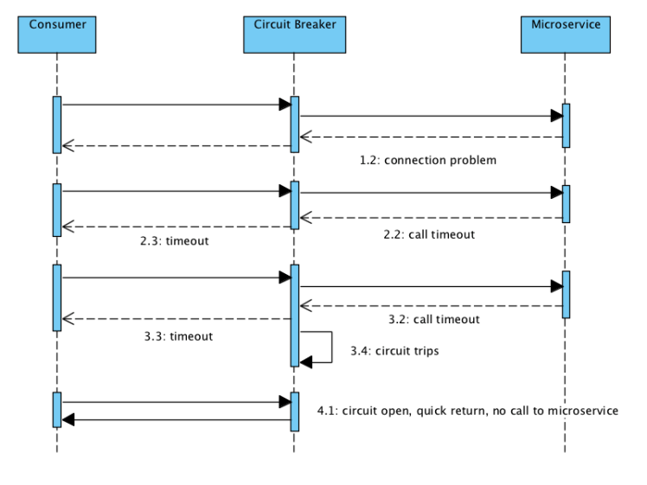
Flow of calls with circuit breaker

Slide 47
Config Server
Centralized configuration is a pattern where the configuration for all services is managed in a central repository rather than being scattered across individual services. Each service pulls its configuration from the central repository on startup.
All configurable parameters of micro-services are written version controlled here.
If we change a property for a microservice, it can reflect that on the fly without redeploying the microservice.
Ensure that the configuration in centralized config server is secured and has role-based access.
A microservice can connect to the config server and identify itself and specify the instance it represents. This enables it to get the required configuration.
Notes:
With microservices architecture what you actually visualize? We visualize a large number of small microservices talking to each other. The number of microservices depends on the size of the enterprise. The interesting part is that each of these microservices can have its own configuration.
If maintaining a single configuration for a large application is difficult, imagine maintaining configurations for hundreds of microservice in different environments
Lets discuss a scenario here - Before the microservices era, we created a properties files where we maintained our configurable parameters so that if we changed the parameter values or added or deleted a parameter, we generally needed to restart the application container. Moreover, think about the environments. Often, we have Development, Staging, and Prod, and each has separate URL for different services. These files are tied to the codebase or statically packaged, so any changes in the properties file means rebuilding and redeploying the application, which is a violation of the microservices principle, which clearly states: Build just once and deploy it in any environment. So, somehow, we need a technology that maintains all properties, and if any properties are changed, it will pick up the changes and reflect them without an application rebuild or restart. The answer to this is "Config Server".

Slide 48
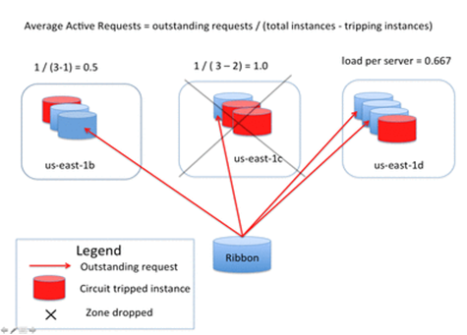
Load Balancer
In order to scale the client and microservices independent of each other, a client interacting with a microservices-based application does not need to know about the instances that are serving it. This is precisely the de-coupling that a reverse proxy or a load balancer provides.
Server-side load balancer
Client load balancer
Client based smart load balancer
Notes:
Server-side load balancer – In server side load balancer application is deployed in multiple application servers. A pool of server is created and a load balancer is put in front of it. This load balancer has a public IP. The client makes a request using that public IP and the load balancer decides in which internal application server it forwards the request by round robin or sticky session algorithm. The problem of server side load balancing is if one or more servers stop responding, we have to manually remove those servers from the load balancer by updating the IP table of the load balancer.
Another problem is that we have to implement a failover policy to provide the client with a seamless experience.
But microservices don't use server side load balancing. They use client side load balancing.
Client-side load balancer – With microservices, we generally create a service discovery where each service instance registers. Now, if one microservice wants to communicate with another microservice, it generally looks up the service registry and the server returns all the instances of the calling microservice to the caller service. Then it was a caller service headache which instance it calls. Client side load balancing maintains an algorithm like round robin or zone specific, by which it can invoke instances of calling services. The advantage is service registry always updates itself; if one instance goes down, it removes it from its registry, so when the client side load balancer talks to the discovery server, it always updates itself, so there is no manual intervention- unlike server side load balancing- to remove an instance. Another advantage is, as the load balancer is in the client side, you can control its load balancing algorithm programmatically. Ribbon provides this facility, so we will use Ribbon for client side load balancing.

Slide 49
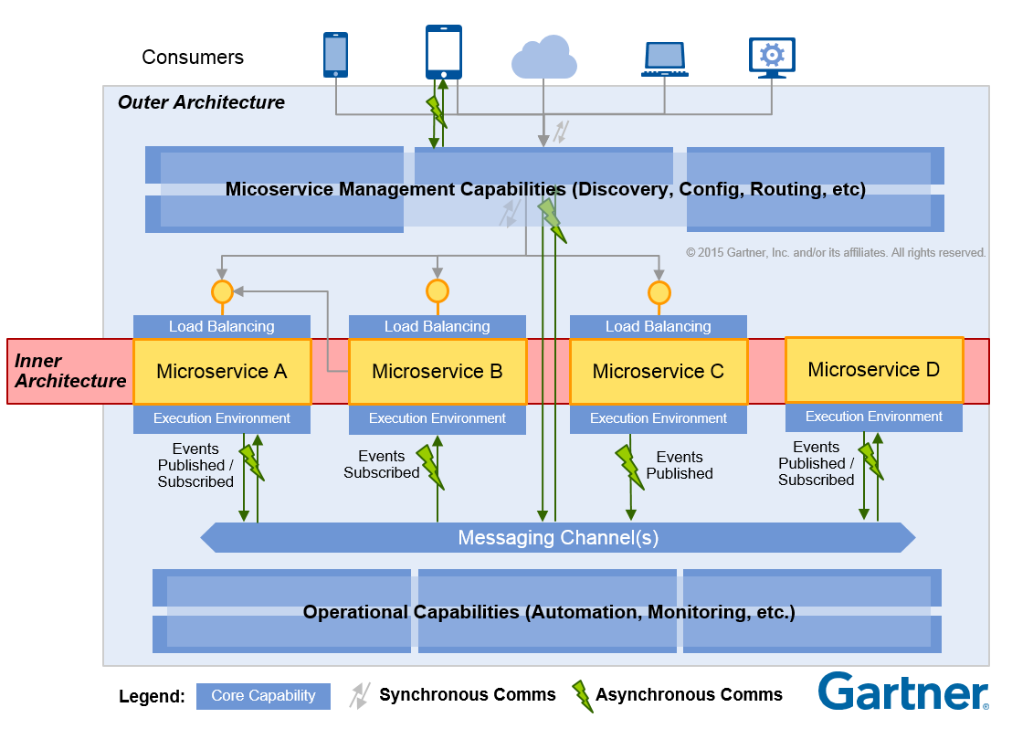
Reference Architecture
API Gateway Server
API Security (OAuth, JWT)
Assembly functions
Load Balancing
Routing
API Management Server
API Developer Portal
Analytic functions
Throughput management
Pay per use
REST Service + Database
Message Broker/MQ
Pub/Sub functions
Asynchronous messaging
Messaging Channels
Operational
Monitoring
Logging
Reporting

Slide 50
Data Management microservices

Slide 51
Factors to consider while designing database for microservices
Services must be loosely coupled so that they can be developed, deployed and scaled independently
Some business transactions may span multiple services.
Some business transactions need to query data that is owned by multiple services
Some queries must join data that is owned by multiple services.
Different services have different data storage requirements.

Slide 52
Database design options
Below are the options in case of relational database:
Share database – each service owns a set of tables that must only be accessed by that service
Increased coupling.
Increased regression testing efforts.
Developers across teams need to coordinate for schema changes to tables.
All microservices tied to specific technology choice.
There could also be run-time conflicts when multiple services are trying to access the same database resources.
Database-per-service – each service has it’s own database.
Notes:
If there is a DB change related to one service, one has to be extreme careful that it doesn't break anything used by other services. Thus increased regression Testing.
If over time developer's realize that a nonrelational DB is a better choice for some services, I again would not be easy because of tight coupling.
Also as all microservices are sharing DB, one change of logic related to one entity would need changes at multiple places. E.g. Payment service, Order service, customer service etc.
All are directly accessing customer data so any change related to customer data needs changes in all these places so loose cohesion.

Slide 53
Database per service
Benefits:
Helps ensure that the services are loosely coupled.
Each service can use the type of database that is best suited to its needs.
Drawbacks:
Implementing business transactions that span multiple services is not straightforward.
Implementing queries that join data that is now in multiple databases is challenging.
Complexity of managing multiple SQL and NoSQL databases

Slide 54
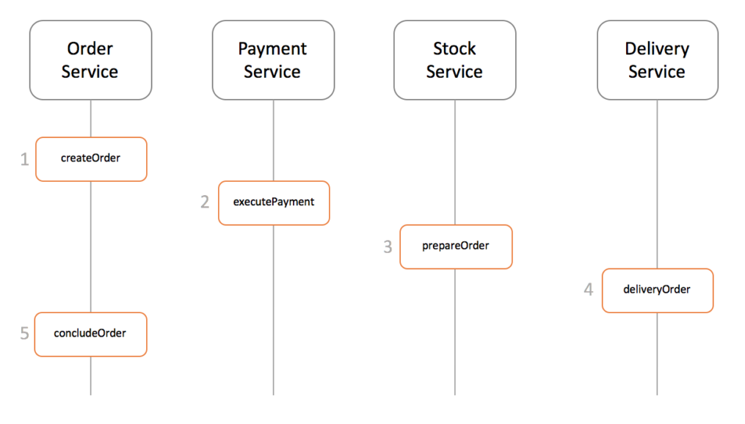
Saga Pattern for implementing distributed transactions
Distributed Transactions: Transactions that span multiple databases.
A saga is a sequence of local transactions. Each local transaction updates the database and publishes a message or event to trigger the next local transaction in the saga.
If a local transaction fails, then the saga executes a series of compensating transactions to undo the changes made by the preceding local transactions.
Below is an example SAGA in e-commerce application:
Notes:
A transaction is a single unit of work made up of multiple DB access operations . A transaction provides a 'All or noting' proposition, means either it will be completed entirely or will have no effect.
e.g. While placing an order we want changes to be done in order table, payment tables, inventory tables etc. But with 'database per microservice' pattern we have all these tables in different databases, so we need to
manage distributed transactions. As our business transactions span multiple services , we require a mechanism to ensure data consistency across services.

Slide 55
Two ways of implementing sagas:
Choreography - No central coordination, each service produces and listens to the other service's events and decides if an action should be taken or not.
Orchestration - a coordinator service is responsible for centralizing the saga's decision making and sequencing business logic.

Slide 56
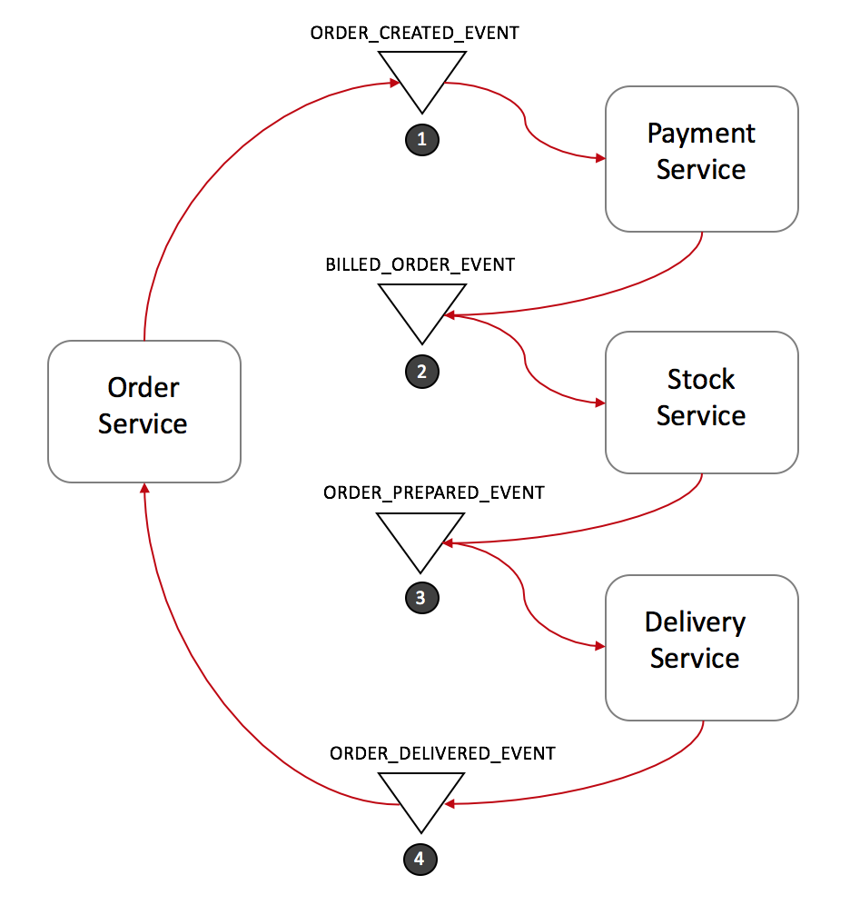
Choreography
Choreography e-commerce example:
Notes:
In the Choreography approach, the first service executes a transaction and then publishes an event. This event is listened to by one or more services, which execute local transactions and publish (or don't publish) new events. The distributed transaction ends when the last service executes its local transaction and does not publish any events, or the event published is not heard by any of the saga's participants.
Order Service saves a new order, set the state as pending and publish an event called ORDER_CREATED_EVENT.
The Payment Service listens to ORDER_CREATED_EVENT, charge the client and publish the event BILLED_ORDER_EVENT.
The Stock Service listens to BILLED_ORDER_EVENT, update the stock, prepare the products bought in the order and publish ORDER_PREPARED_EVENT.
Delivery Service listens to ORDER_PREPARED_EVENT and then pick up and deliver the product. At the end, it publishes an ORDER_DELIVERED_EVENT
Finally, Order Service listens to ORDER_DELIVERED_EVENT and set the state of the order as concluded.

Slide 57
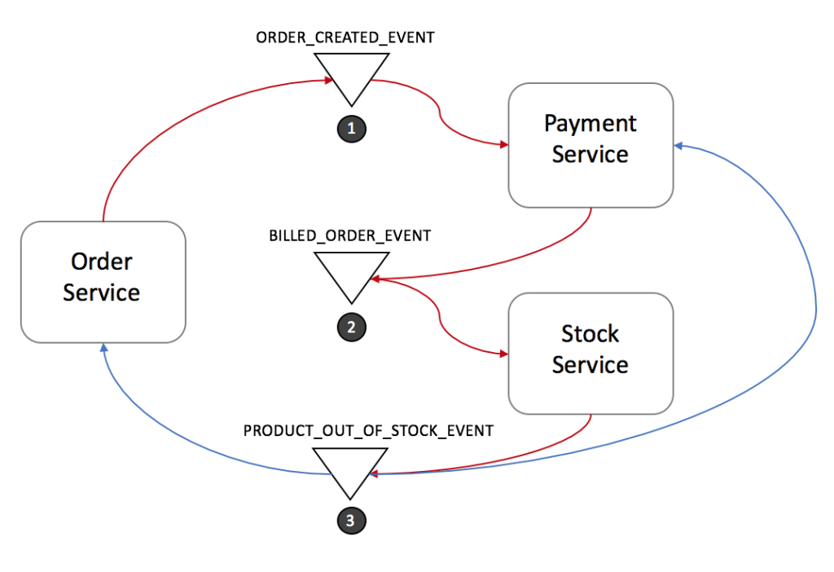
Choreography Rollback flow
For distributed transactions , a compensating transaction needs to be performed in case of any failure.
Notes:
Stock Service produces PRODUCT_OUT_OF_STOCK_EVENT;
Both Order Service and Payment Service listen to the previous message:
Payment Service refund the client.
Order Service set the order state as failed.
Note that it is crucial to define a common shared ID for each transaction, so whenever you throw an event, all listeners can know right away which transaction it refers to.

Slide 58
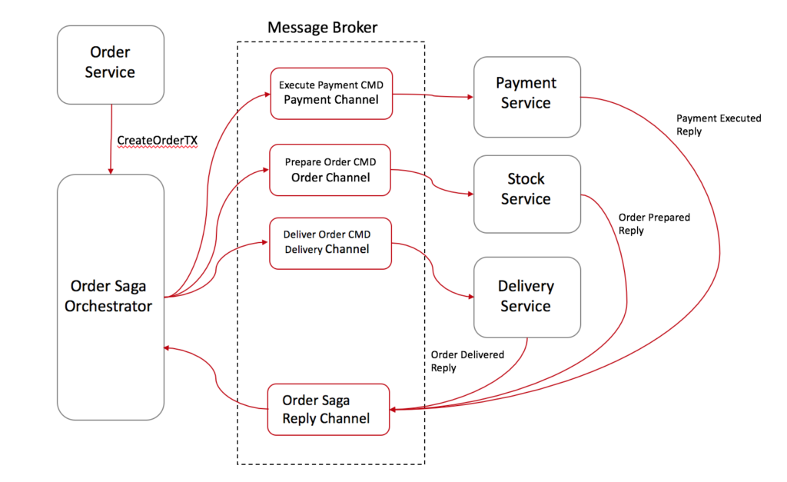
Orchestration
Orchestration e-commerce example:
Notes:
Order Service saves a pending order and asks Order Saga Orchestrator (OSO) to start a create order transaction.
OSO sends an Execute Payment command to Payment Service, and it replies with a Payment Executed message
OSO sends a Prepare Order command to Stock Service, and it replies with an Order Preparedmessage
OSO sends a Deliver Order command to Delivery Service, and it replies with an Order Deliveredmessage
In the case above, Order Saga Orchestrator knows what is the flow needed to execute a "create order" transaction. If anything fails, it is also responsible for coordinating the rollback by sending commands to each participant to undo the previous operation.
A standard way to model a saga orchestrator is a State Machine where each transformation corresponds to a command or message. State machines are an excellent pattern to structure a well-defined behavior as they are easy to implement and particularly great for testing.

Slide 59
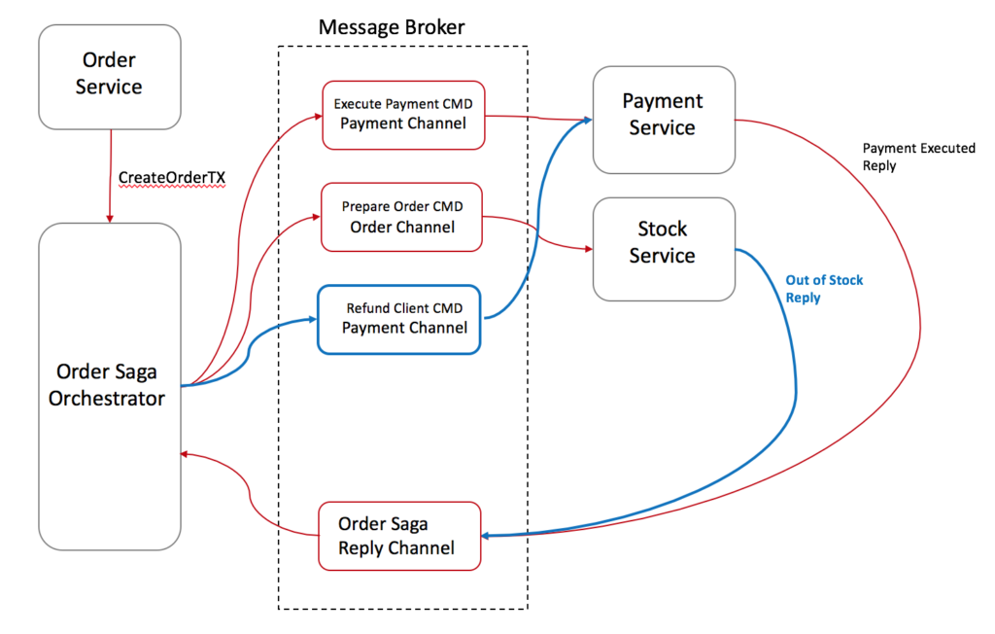
Rollbacks are a lot easier when you there is an orchestrator to coordinate everything:

Slide 60
Thank You!

